Slide 1
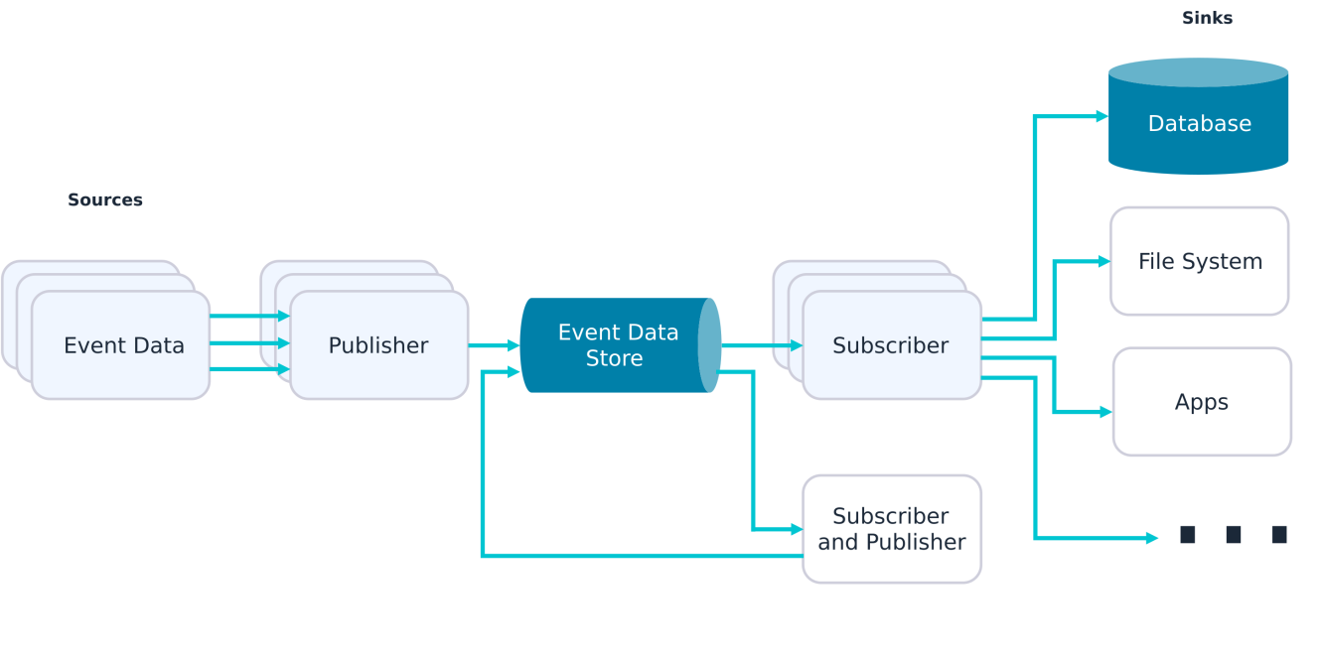
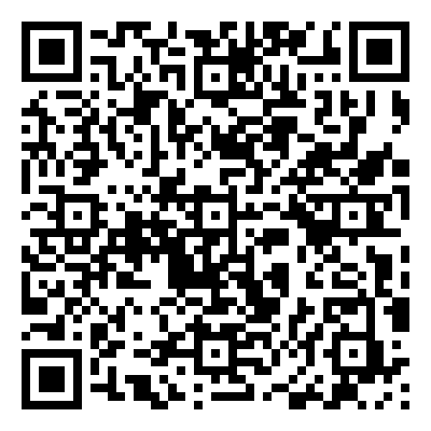
Lab 04 - Event-Driven Architecture
https://bit.ly/4bOLvJ1

